Slide 1



Advanced Digital System Design Course

Slide 2



Advanced Digital System
Design Course

Slide 3
Potenciación
Entera

Slide 4
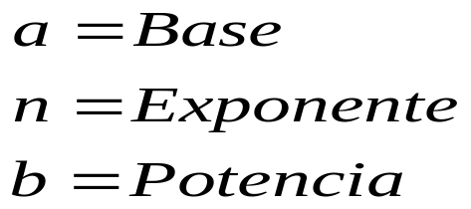
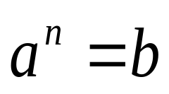
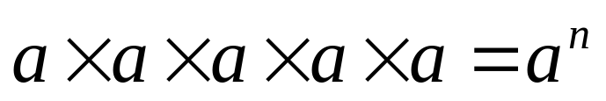


CONCEPTOS
La potenciación se usa cuando se conoce la base, el exponente y se desconoce la potencia.
La potenciaciones la simplificación de la multiplicación cuando se están multiplicando números iguales

Slide 5
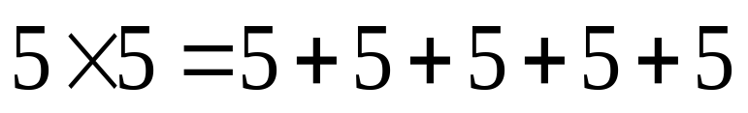
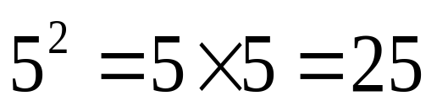
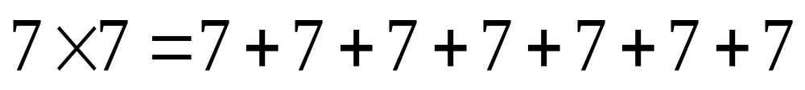
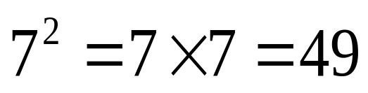
CONCEPTOS
Observemos:

Slide 6
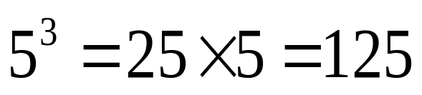
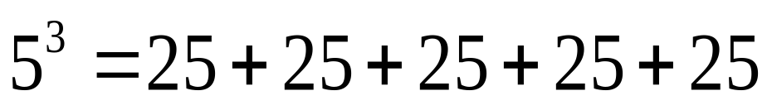
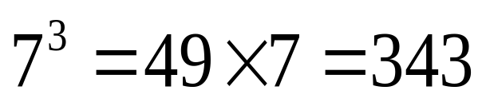
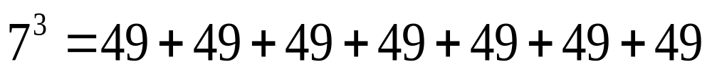
CONCEPTOS
Observemos:

Slide 7
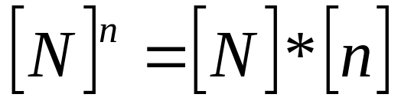
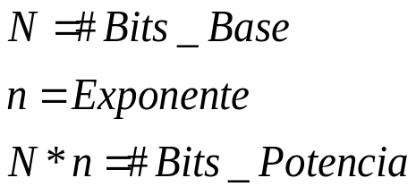

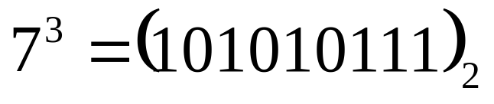

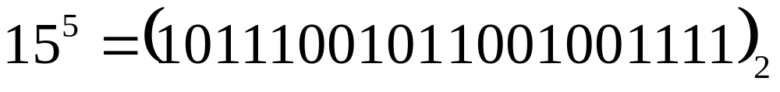
CONCEPTOS
En digitales
Entonces:

Slide 8
IDDLE
S0
0
START
1
S1
B ← # Base
A ← “Ø”
Count _B ← # Base --1
Count _E ← Exponente --1
# Base
N
S2
Clk
BASE
Aux ← B
W/R
S3
N
A ← A + Aux
N*n
Asel
1
0
Z_B
OR
Z_E
1
Clk
AUXILIAR
W/R
0
S4
N*n
A ← A + Aux
Count _B ← Count _B -- 1
N*n
0
Z_B
1
S5
Count _E ← Count _E -- 1
Count _B ← # Base -- 1
Z
ACUMULADOR
Clk
1
W/R
Z_E
0
S6
S7
Aux ← A
END

Slide 9

FUNCIONAMIENTO
Vamos a elevar
Reg. B | Reg. Aux | Reg. A | Count_B | Count_E
B ← Base
A ← Ø
Count_B ← # Base -1
Count_E ← # Expo. -1
1000 |  | 0000 | 7 | 0
 | 1000
 |  | 1000
Aux ← B
 |  | END
A ← A + Aux
IF
Z_B = ‘1’ OR Z_E = ‘1’
THEN
End
ELSE
A ← A + Aux
Count_B ← Count_B -1

Slide 10

Reg. B | Reg. Aux | Reg. A | Count_B | Count_E
Vamos a elevar
101 |  | 000 | 4 | 2
B ← Base
A ← Ø
Count_B ← # Base -1
Count_E ← # Expo. -1
 | 101
 |  | 101
Aux ← B
A ← A + Aux

Slide 11
Reg. B | Reg. Aux | Reg. A | Count_B | Count_E
Vamos a elevar
101 |  | 000 | 4 | 2
 | 101
 |  | 101
IF
Z_B = ‘1’ OR Z_E = ‘1’
THEN
End
ELSE
A ← A + Aux
Count_B ← Count_B -1
 |  | 1010 | 3

Slide 12
Reg. B | Reg. Aux | Reg. A | Count_B | Count_E
Vamos a elevar
101 |  | 000 | 4 | 2
 | 101
 |  | 101
 |  | 1010 | 3
IF
Z_B= ‘1’
THEN
Count_E ← Count_E -1
Count_B ← # Base -1
ELSE
A ← A + Aux
Count_B ← Count_B -1
 |  | 1111 | 2
 |  | 10100 | 1
 |  | 11001 | 0
 |  |  | 4 | 1

Slide 13
Reg. B | Reg. Aux | Reg. A | Count_B | Count_E
Vamos a elevar
101 |  | 000 | 4 | 2
 | 101
 |  | 101
 |  | 1010 | 3
IF
Z_E = ‘1’
THEN
End
ELSE
Aux ← A
A ← A + Aux
Count_B ← Count_B -1
 |  | 1111 | 2
 |  | 10100 | 1
 |  | 11001 | 0
 |  |  | 4 | 1
 | 11001
 |  | 110010 | 3

Slide 14
Reg. B | Reg. Aux | Reg. A | Count_B | Count_E
Vamos a elevar
101 |  | 000 | 4 | 2
 | 101
IF
Z_B= ‘1’
THEN
Count_E ← Count_E -1
Count_B ← # Base -1
ELSE
A ← A + Aux
Count_B ← Count_B -1
 |  | 101
 |  | 1010 | 3
 |  | 1111 | 2
 |  | 10100 | 1
 |  | 11001 | 0
 |  |  | 4 | 1
 | 11001
 |  | 110010 | 3
IF
Z_E = ‘1’
THEN
End
 |  | 1001011 | 2
 |  | 1100100 | 1
 |  | 1111101 | 0
 |  |  | 4 | 0
 |  | END

Slide 15

FUNCIONAMIENTO
Vamos a elevar
Reg. B | Reg. Aux | Reg. A | Count_B | Count_E
B ← Base
A ← Ø
Count_B ← # Base -1
Count_E ← # Expo. -1
1 |  | 0 | 0 | 3
 | 1
 |  | 1
Aux ← B
 |  | END
A ← A + Aux
IF
Z_B = ‘1’ OR Z_E = ‘1’
THEN
End
ELSE
A ← A + Aux
Count_B ← Count_B -1

Slide 16
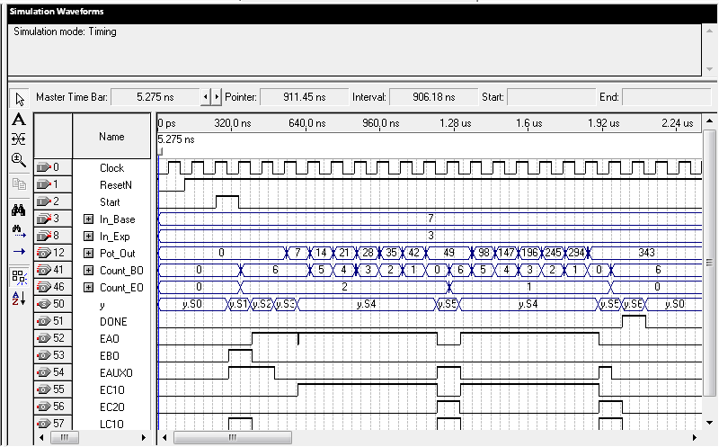
SIMULACIONES

Slide 17
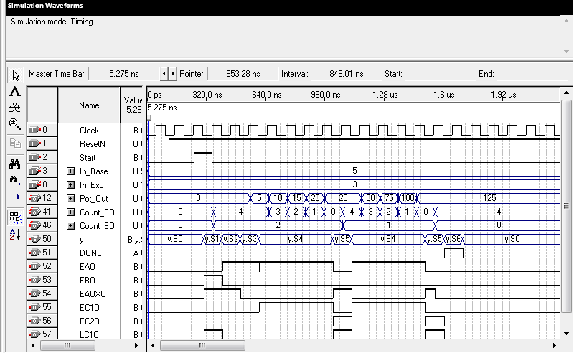
SIMULACIONES

Slide 18
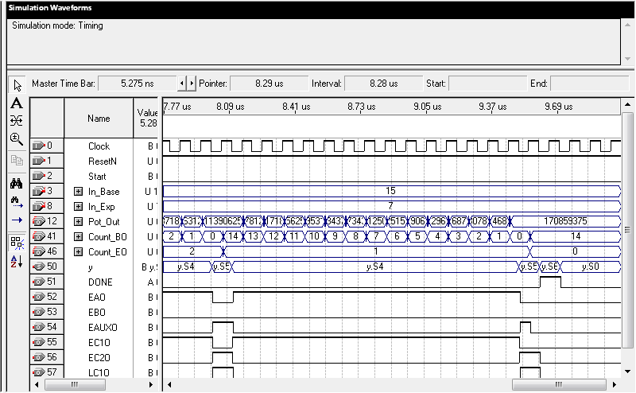
SIMULACIONES

Slide 19
IDDLE
0
START
1
S1
B ← # Base
A ← “Ø”
Count _B ← # Base --1
Count _E ← Exponente --1
F_E
1
0
S2
Aux ← B
S3
A ← A + Aux
Z_B
OR
Z_E
1
0
S4
A ← A + Aux
Count _B ← Count _B -- 1
0
Z_B
1
S5
Count _E ← Count _E -- 1
Count _B ← # Base -- 1
0
Z_E
1
0
S6
Aux ← A
END

Slide 20

FUNCIONAMIENTO
Vamos a elevar
Reg. B | Reg. Aux | Reg. A | Count₁ | Count₂
B ← Base
A ← Ø
Count₁ ← # Base -1
Count₂ ← # Expo. -1
1000 |  | 0000 | 7 | 7
 | 0000 | 0001
 |  | END
IF
F_E = 1
THEN
‘1’ AND End
ELSE
Aux ← B

Slide 21
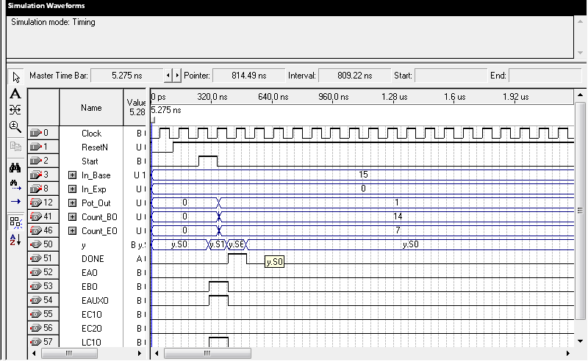
SIMULACIONES

